Slide 1
Welcome to Y1 Maths information evening

Slide 2
Alex Parry
St Bonaventure’s Primary School
alexandra.parry@bristol-schools.uk

Slide 3
What do children in Y1 need to know?

Slide 4
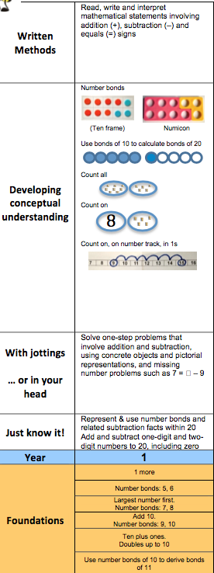
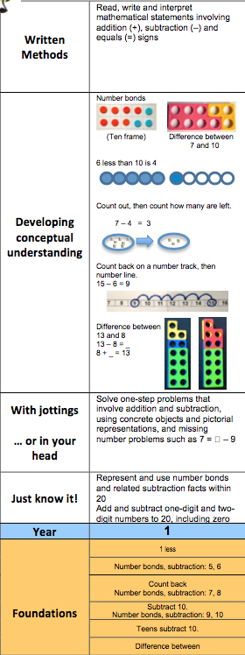
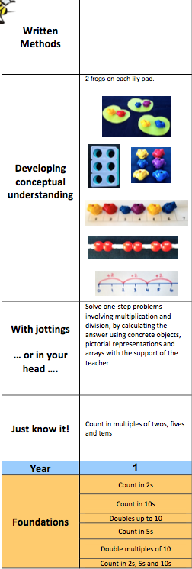
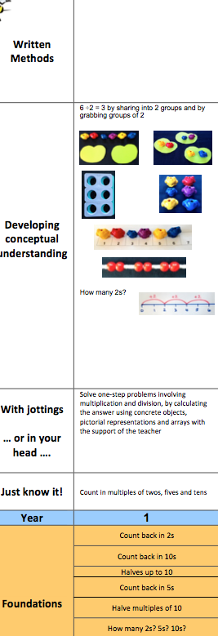
 | Addition | Subtraction | Multiplication | Division | Algebra | Fractions

Slide 5
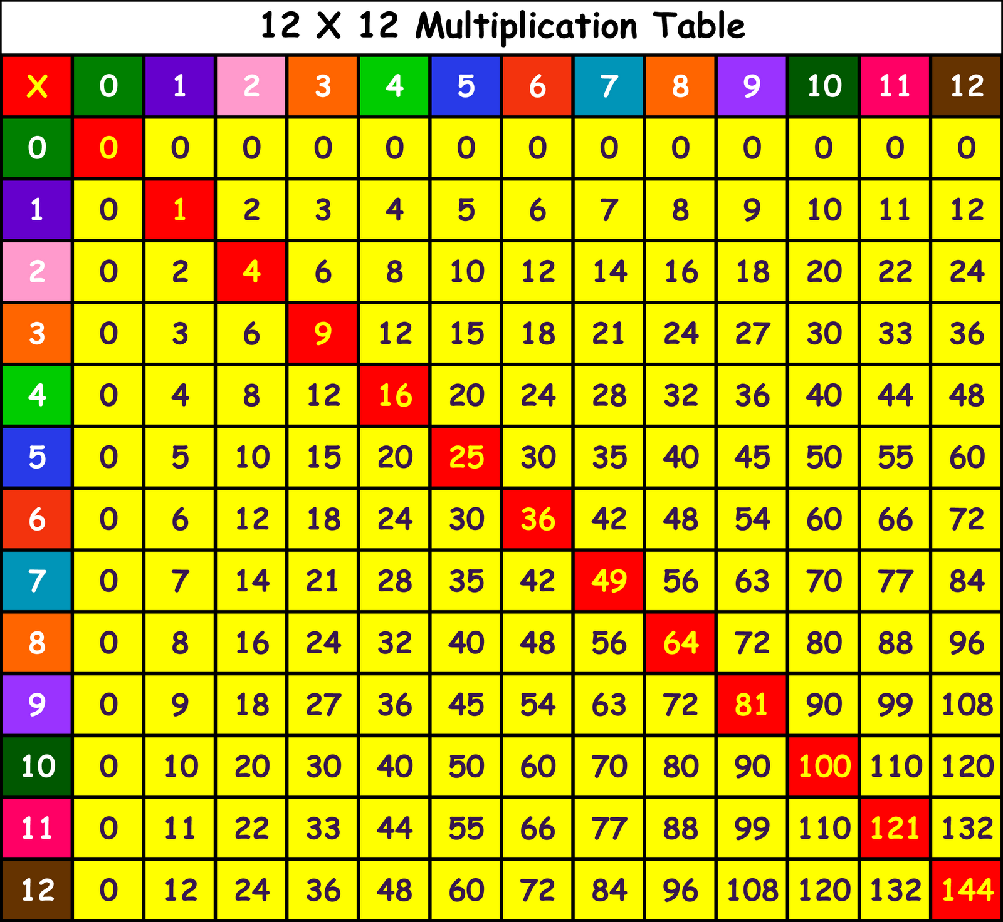
Multiplication grid….

Slide 6
Adding 1
Bonds to 10
Adding 10
Bridging/
compensating
Y1 facts
Y2
facts
Adding 2
Adding 0
Doubles
Near doubles
+ | 0 | 1 | 2 | 3 | 4 | 5 | 6 | 7 | 8 | 9 | 10
0 | 0 + 0 | 0 + 1 | 0 + 2 | 0 + 3 | 0 + 4 | 0 + 5 | 0 + 6 | 0 + 7 | 0 + 8 | 0 + 9 | 0 + 10
1 | 1 + 0 | 1 + 1 | 1 + 2 | 1 + 3 | 1 + 4 | 1 + 5 | 1 + 6 | 1 + 7 | 1 + 8 | 1 + 9 | 1 + 10
2 | 2 + 0 | 2 + 1 | 2 + 2 | 2 + 3 | 2 + 4 | 2 + 5 | 2 + 6 | 2 + 7 | 2 + 8 | 2 + 9 | 2 + 10
3 | 3 + 0 | 3 + 1 | 3 + 2 | 3 + 3 | 3 + 4 | 3 + 5 | 3 + 6 | 3 + 7 | 3 + 8 | 3 + 9 | 3 + 10
4 | 4 + 0 | 4 + 1 | 4 + 2 | 4 + 3 | 4 + 4 | 4 + 5 | 4 + 6 | 4 + 7 | 4 + 8 | 4 + 9 | 4 + 10
5 | 5 + 0 | 5 + 1 | 5 + 2 | 5 + 3 | 5 + 4 | 5 + 5 | 5 + 6 | 5 + 7 | 5 + 8 | 5 + 9 | 5 + 10
6 | 6 + 0 | 6 + 1 | 6 + 2 | 6 + 3 | 6 + 4 | 6 + 5 | 6 + 6 | 6 + 7 | 6 + 8 | 6 + 9 | 6 + 10
7 | 7 + 0 | 7 + 1 | 7 + 2 | 7 + 3 | 7 + 4 | 7 + 5 | 7 + 6 | 7 + 7 | 7 + 8 | 7 + 9 | 7 + 10
8 | 8 + 0 | 8 + 1 | 8 + 2 | 8 + 3 | 8 + 4 | 8 + 5 | 8 + 6 | 8 + 7 | 8 + 8 | 8 + 9 | 8 + 10
9 | 9 + 0 | 9 + 1 | 9 + 2 | 9 + 3 | 9 + 4 | 9 + 5 | 9 + 6 | 9 + 7 | 9 + 8 | 9 + 9 | 9 + 10
10 | 10 + 0 | 10 + 1 | 10 + 2 | 10 + 3 | 10 + 4 | 10 + 5 | 10 + 6 | 10 + 7 | 10 + 8 | 10 + 9 | 10 + 10

Slide 7
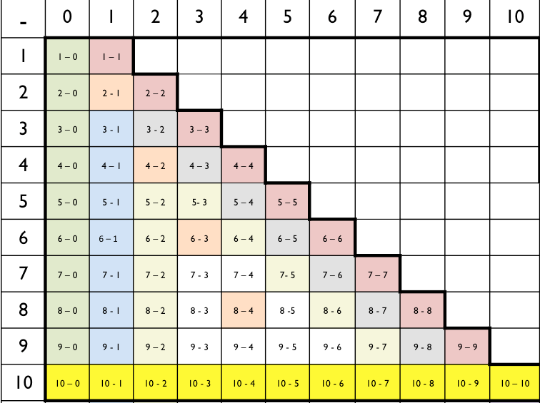
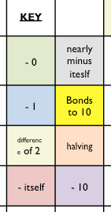

Slide 9
Which representations are we using with your children?

Slide 10
The Part Part Whole model….

Slide 11
Part-Part-Whole Models

Slide 12
Part-Part-Whole Models

Slide 14
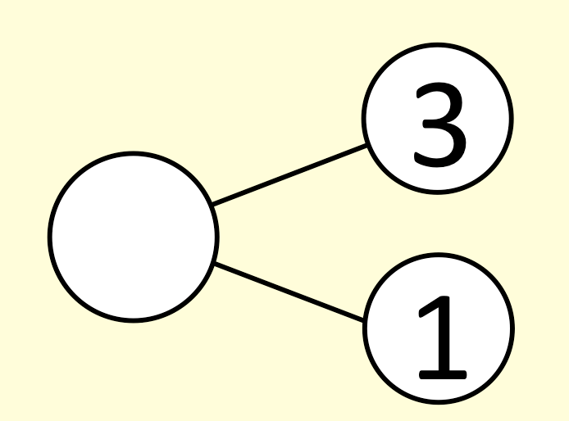
Cherries….

Slide 15
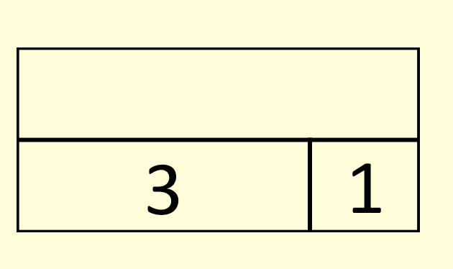
Rectangles

Slide 16
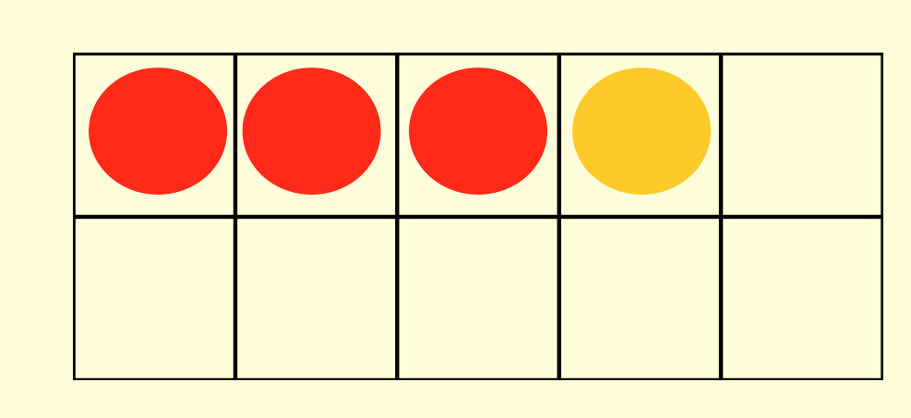
10 frame

Slide 17
3 + 1=
4
3
4
4
1
3
1

Slide 18
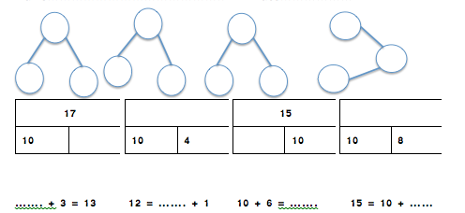
How will we challenge and support your child?

Slide 19
Where does this lead to in later years?

Slide 20
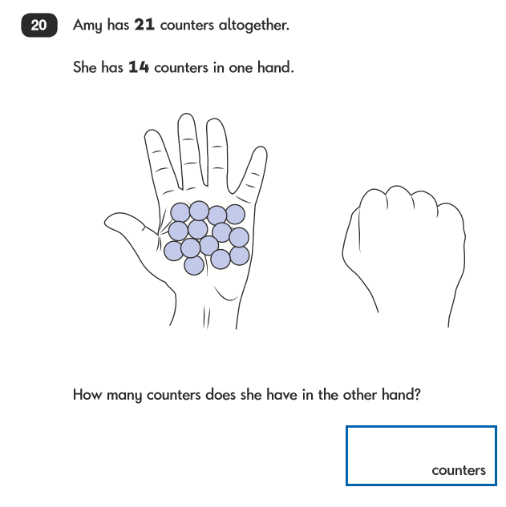
Y2
21
14
21 – 14 =

Slide 21
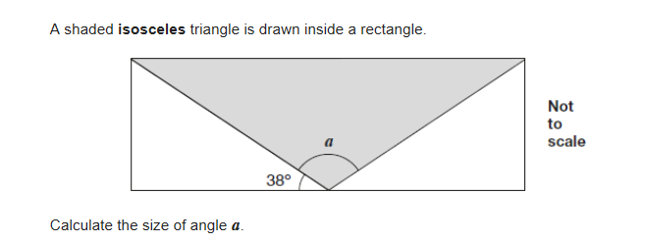
Y6

Slide 22
How can you help your child?

Slide 23
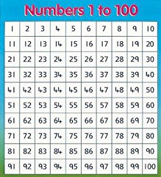
2, 5, 10 x table

Slide 24
Adding 1
Bonds to 10
Adding 10
Bridging/
compensating
Y1 facts
Y2
facts
Adding 2
Adding 0
Doubles
Near doubles
+ | 0 | 1 | 2 | 3 | 4 | 5 | 6 | 7 | 8 | 9 | 10
0 | 0 + 0 | 0 + 1 | 0 + 2 | 0 + 3 | 0 + 4 | 0 + 5 | 0 + 6 | 0 + 7 | 0 + 8 | 0 + 9 | 0 + 10
1 | 1 + 0 | 1 + 1 | 1 + 2 | 1 + 3 | 1 + 4 | 1 + 5 | 1 + 6 | 1 + 7 | 1 + 8 | 1 + 9 | 1 + 10
2 | 2 + 0 | 2 + 1 | 2 + 2 | 2 + 3 | 2 + 4 | 2 + 5 | 2 + 6 | 2 + 7 | 2 + 8 | 2 + 9 | 2 + 10
3 | 3 + 0 | 3 + 1 | 3 + 2 | 3 + 3 | 3 + 4 | 3 + 5 | 3 + 6 | 3 + 7 | 3 + 8 | 3 + 9 | 3 + 10
4 | 4 + 0 | 4 + 1 | 4 + 2 | 4 + 3 | 4 + 4 | 4 + 5 | 4 + 6 | 4 + 7 | 4 + 8 | 4 + 9 | 4 + 10
5 | 5 + 0 | 5 + 1 | 5 + 2 | 5 + 3 | 5 + 4 | 5 + 5 | 5 + 6 | 5 + 7 | 5 + 8 | 5 + 9 | 5 + 10
6 | 6 + 0 | 6 + 1 | 6 + 2 | 6 + 3 | 6 + 4 | 6 + 5 | 6 + 6 | 6 + 7 | 6 + 8 | 6 + 9 | 6 + 10
7 | 7 + 0 | 7 + 1 | 7 + 2 | 7 + 3 | 7 + 4 | 7 + 5 | 7 + 6 | 7 + 7 | 7 + 8 | 7 + 9 | 7 + 10
8 | 8 + 0 | 8 + 1 | 8 + 2 | 8 + 3 | 8 + 4 | 8 + 5 | 8 + 6 | 8 + 7 | 8 + 8 | 8 + 9 | 8 + 10
9 | 9 + 0 | 9 + 1 | 9 + 2 | 9 + 3 | 9 + 4 | 9 + 5 | 9 + 6 | 9 + 7 | 9 + 8 | 9 + 9 | 9 + 10
10 | 10 + 0 | 10 + 1 | 10 + 2 | 10 + 3 | 10 + 4 | 10 + 5 | 10 + 6 | 10 + 7 | 10 + 8 | 10 + 9 | 10 + 10

