Slide 1
What is the most important meal of the day?

Slide 2
Why is breakfast so important?

Slide 4
Brilliant Breakfasts for Brainy Bon’s!

Slide 5
Email me photos of your brilliant breakfasts
And I’ll pop them on the school website…

Slide 6
And the winner is… How will they be judged?
Healthiness
Creativity
Funny title

Slide 7
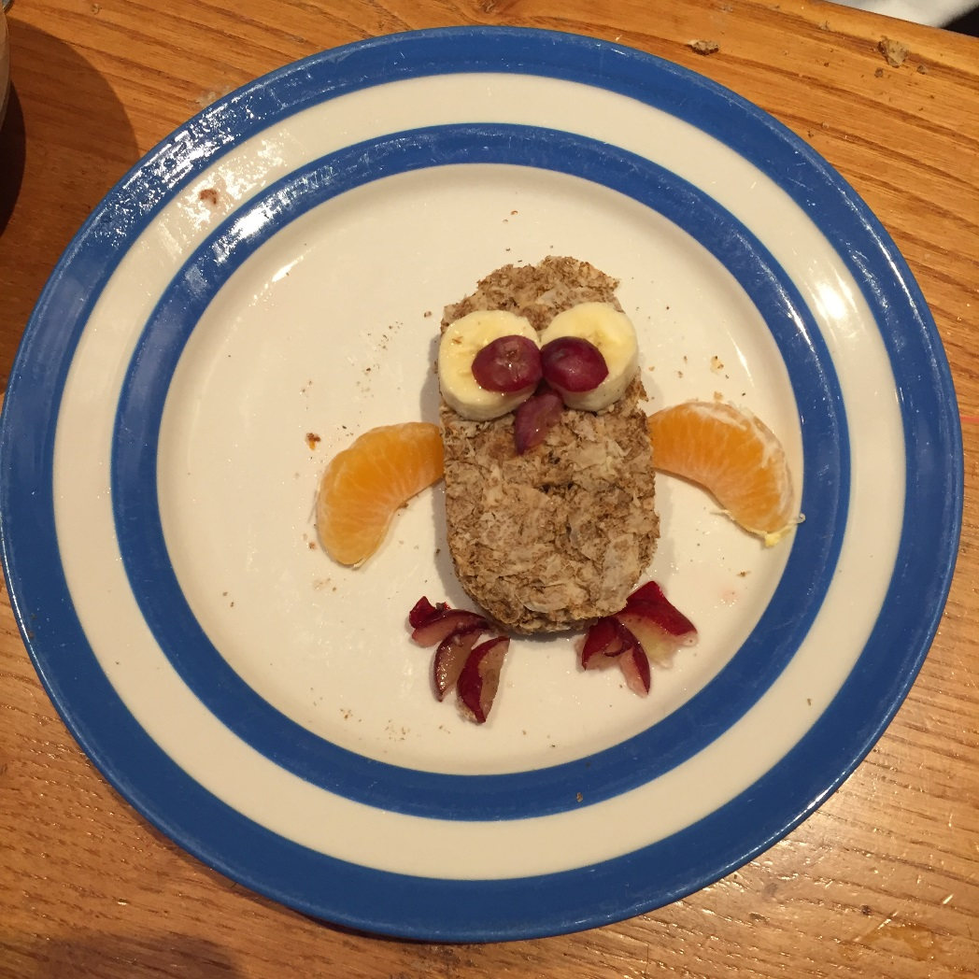
Tweetabix!

Slide 8
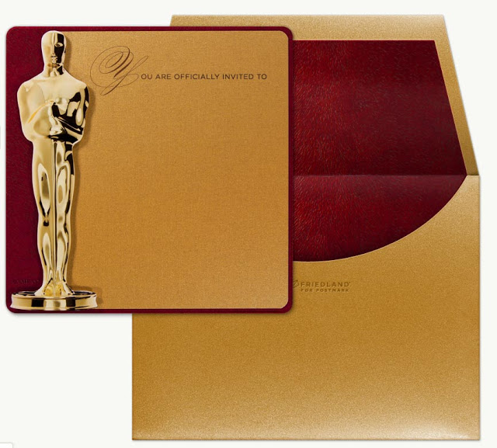
…and
the
prize
is?

Slide 9
We need your breakfasts!

Slide 10
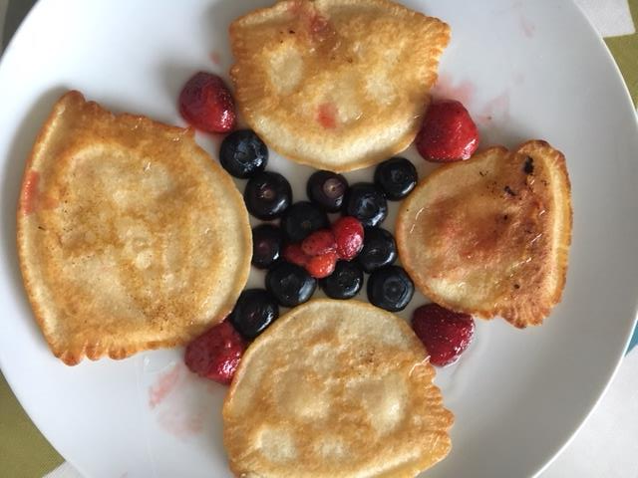
Berry Exciting Pancakes!

Slide 11
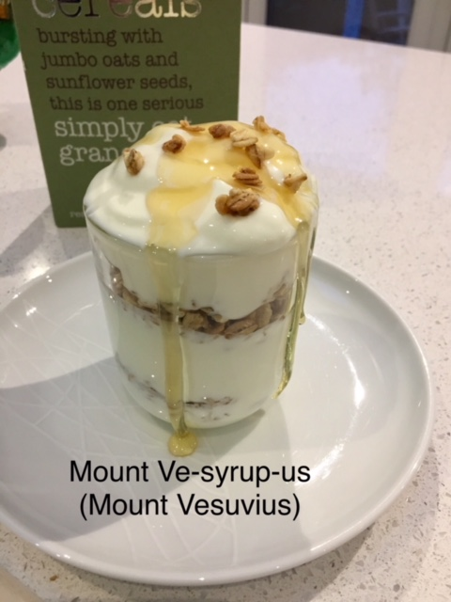

Slide 12
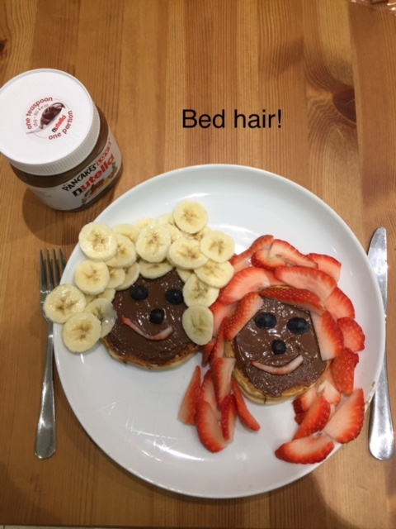

Slide 13
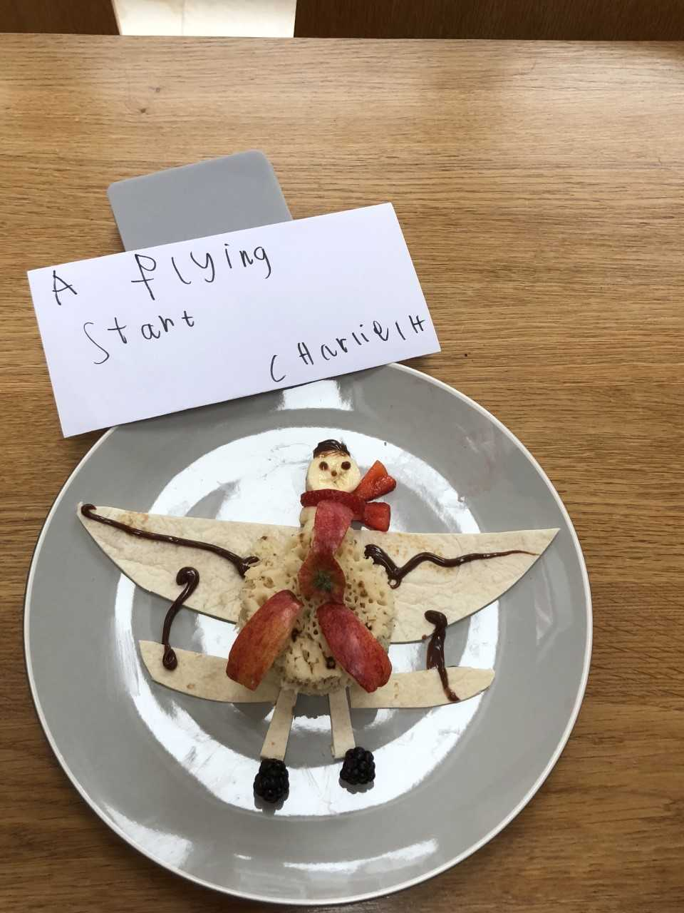

Slide 14
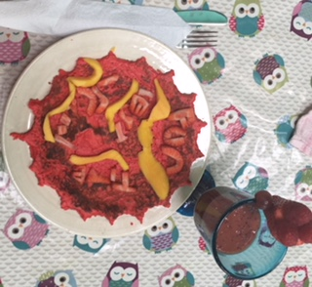
Brain booster

Slide 15
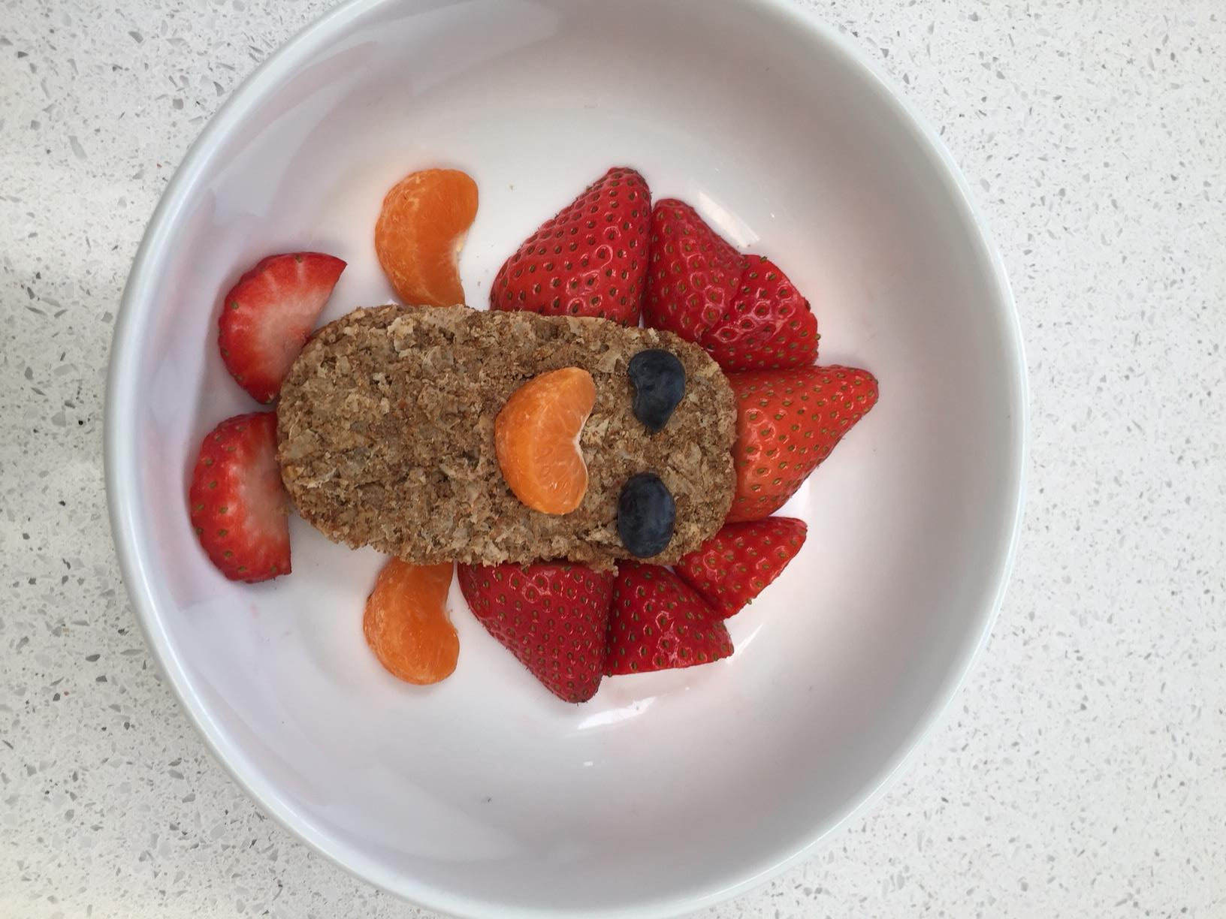
Mr Bix

Slide 16
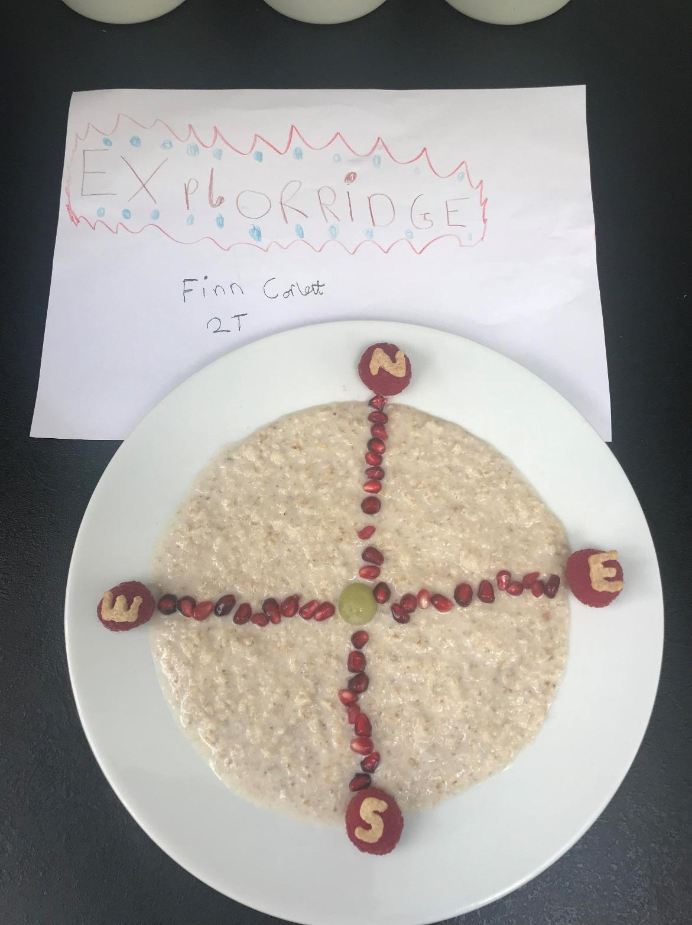

Slide 17
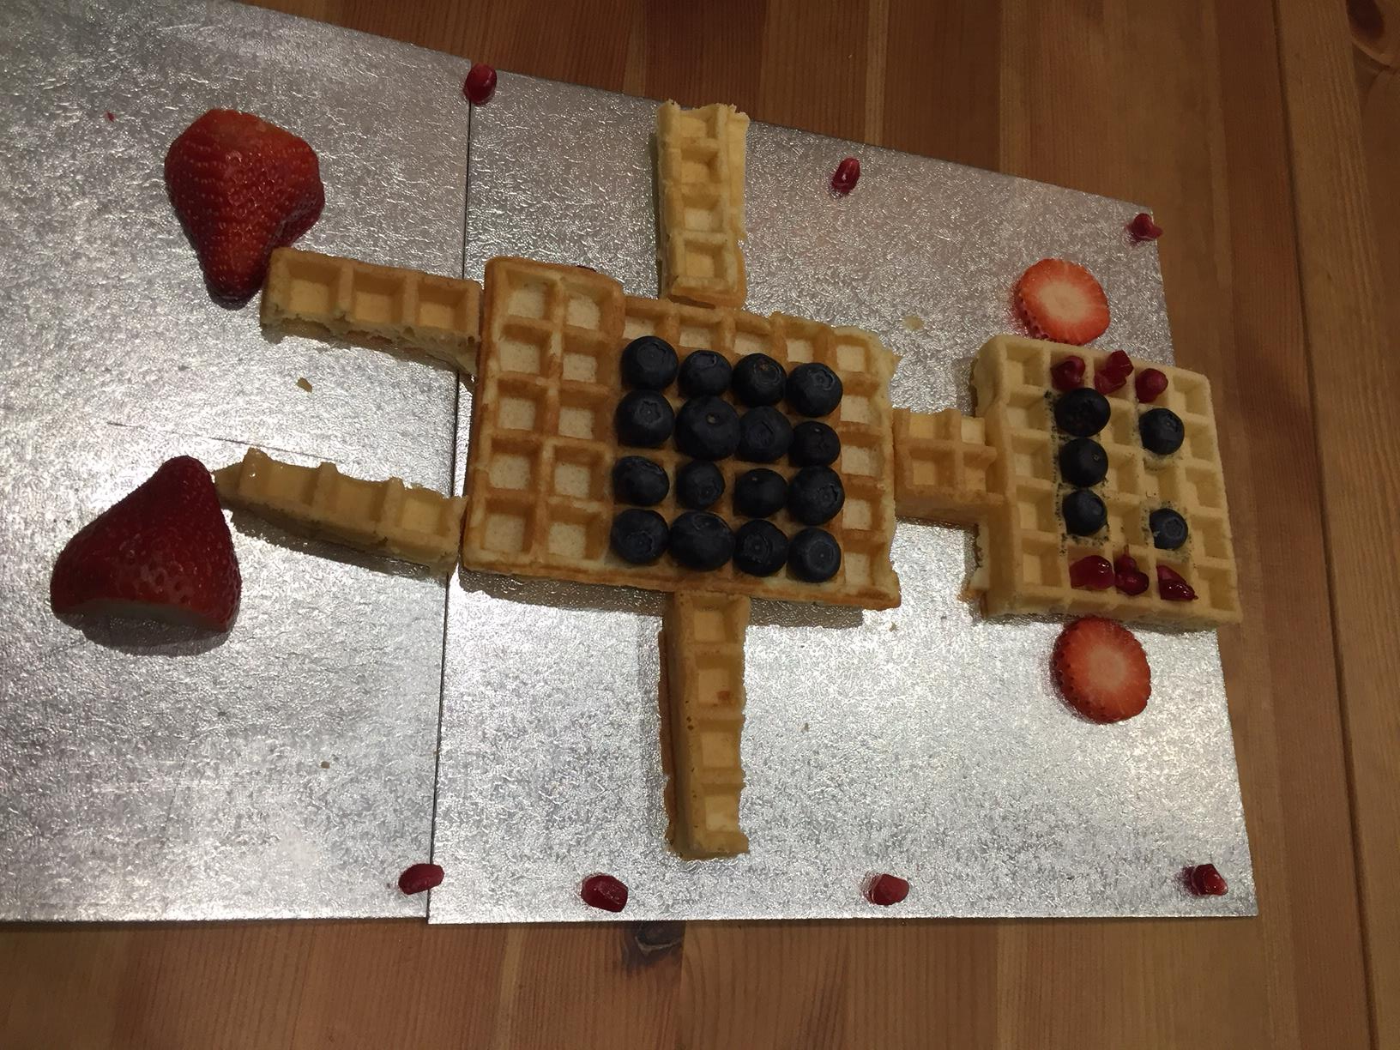
Brain Bot

Slide 18
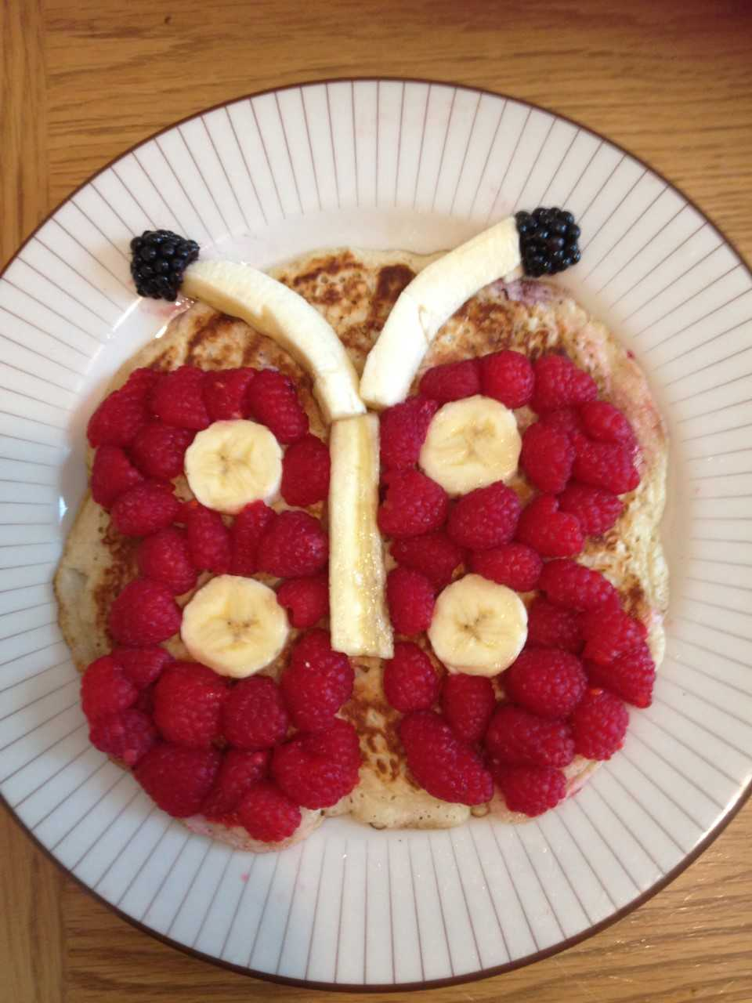
Butterpan

Slide 19
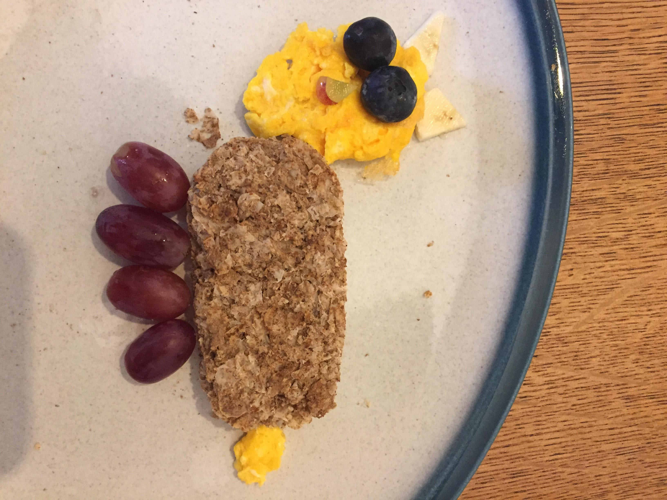
Scrambled cat

Slide 20
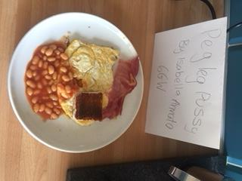

Slide 21
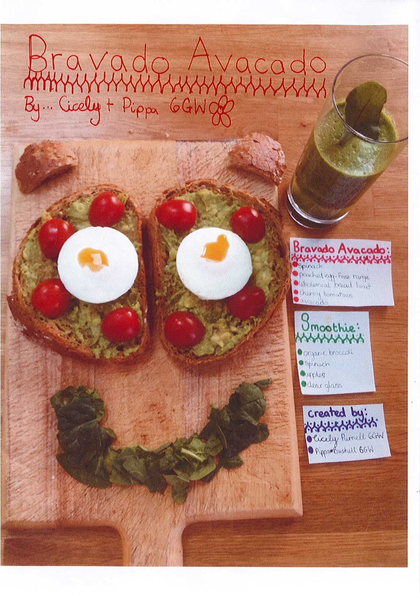

Slide 22
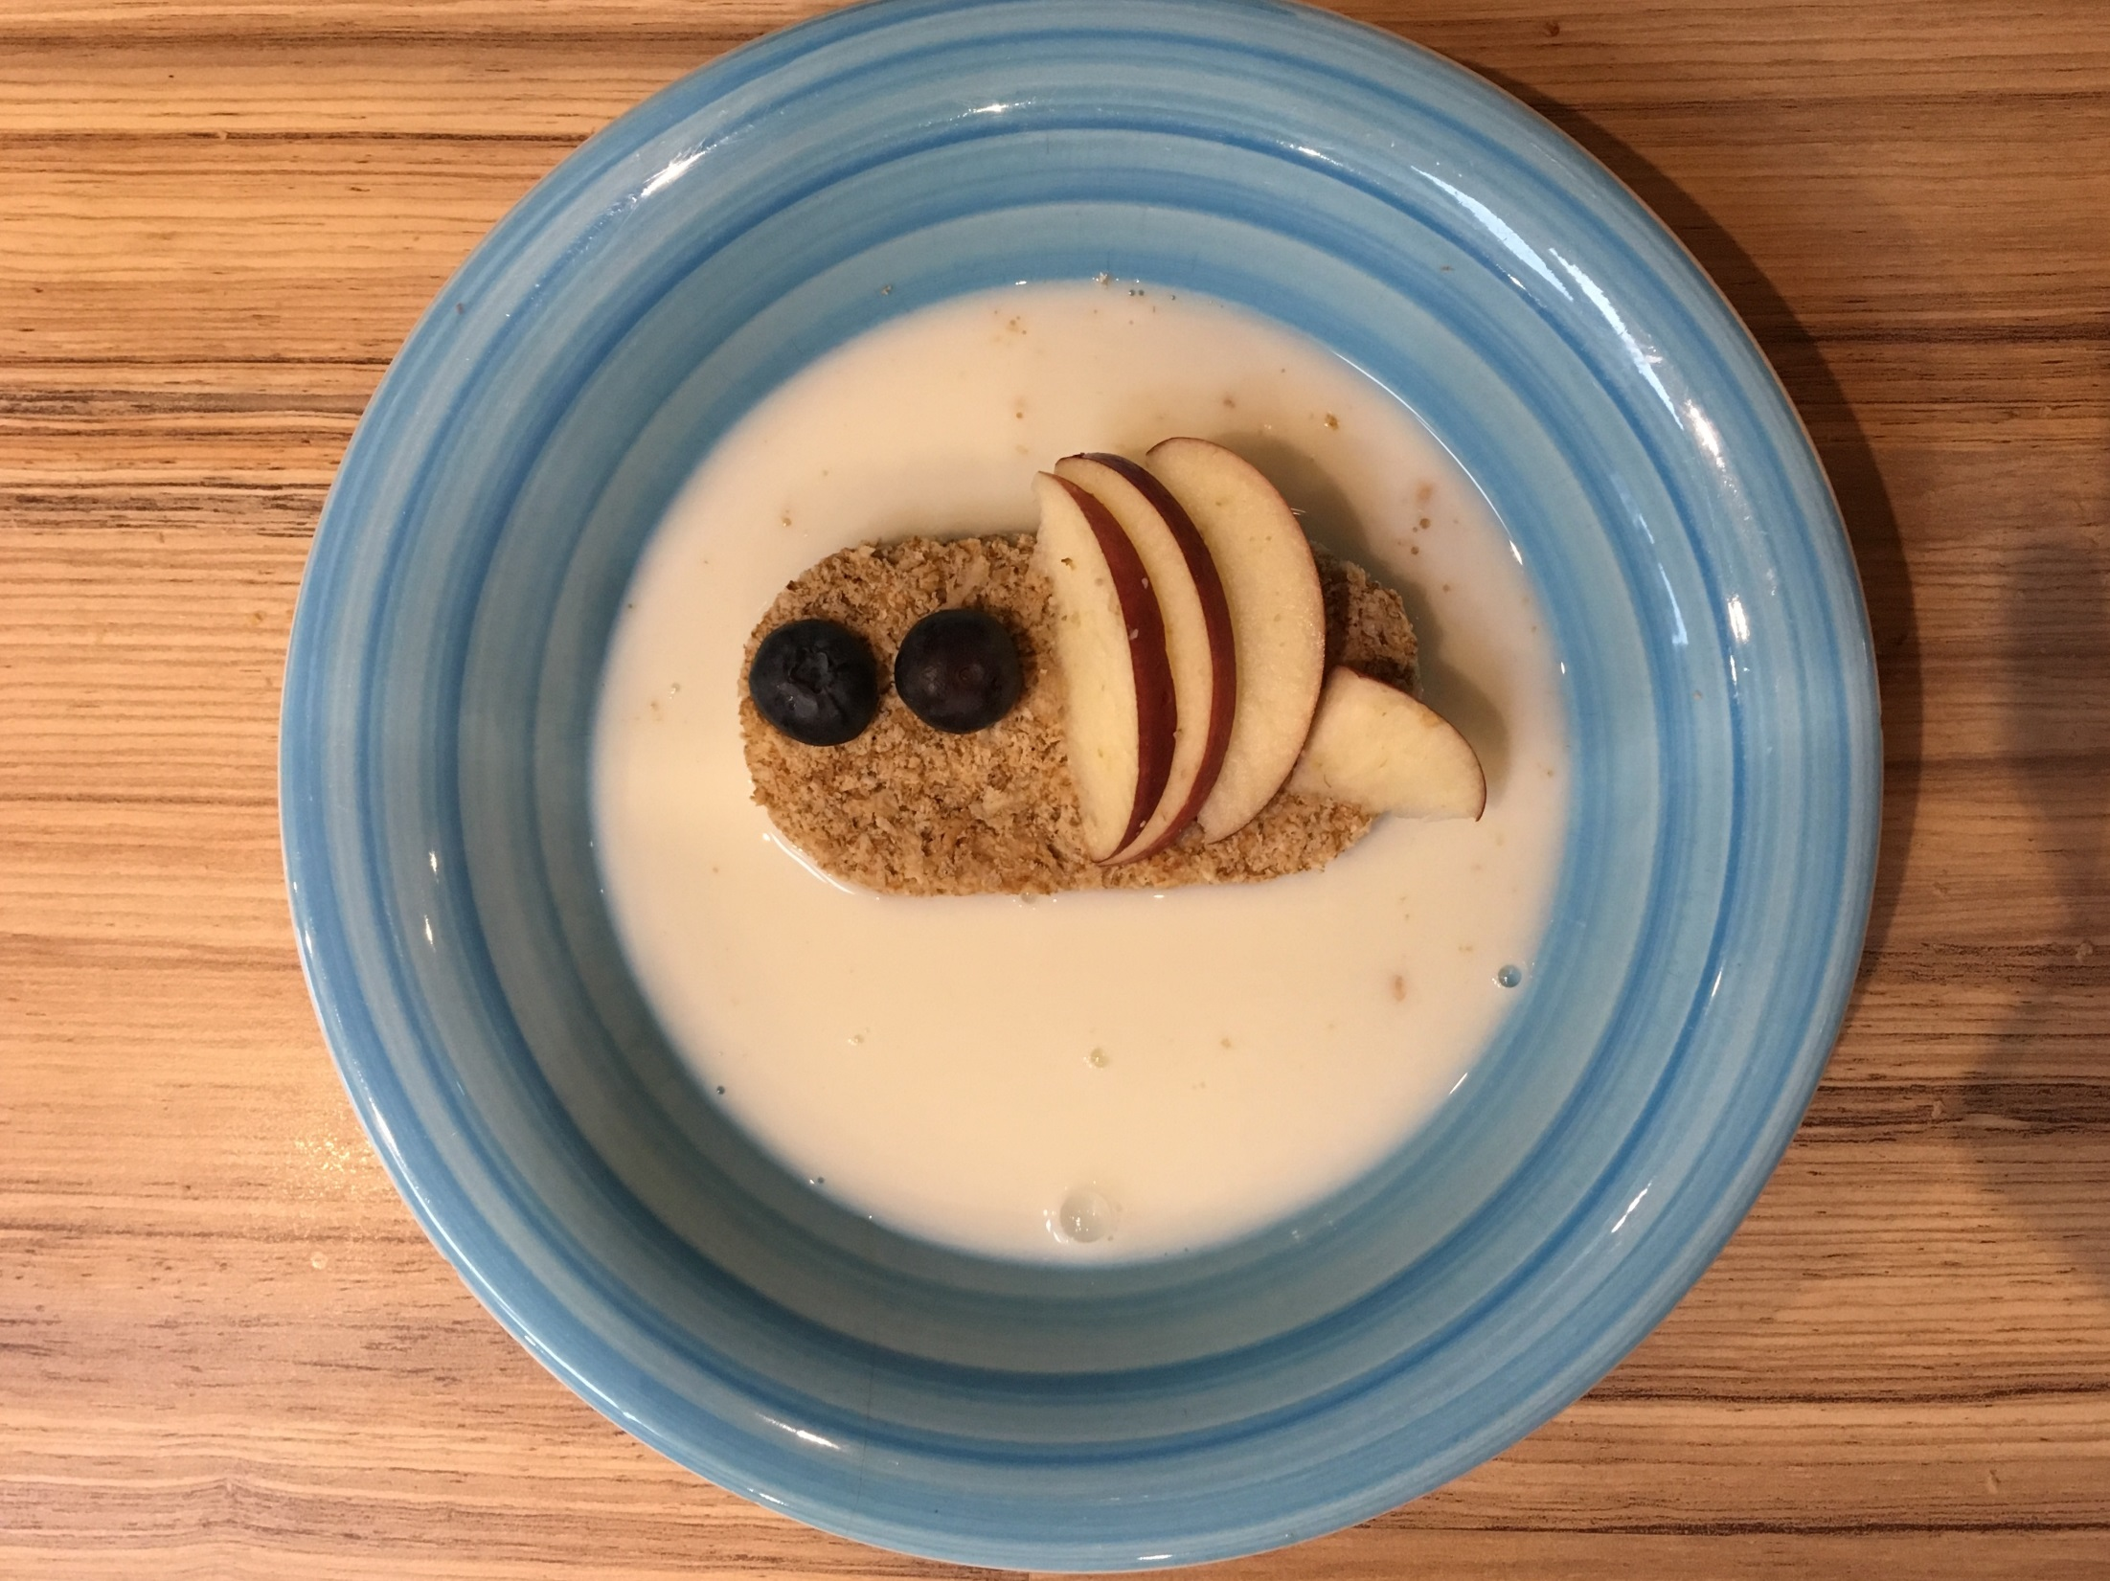
Beelicious

Slide 23
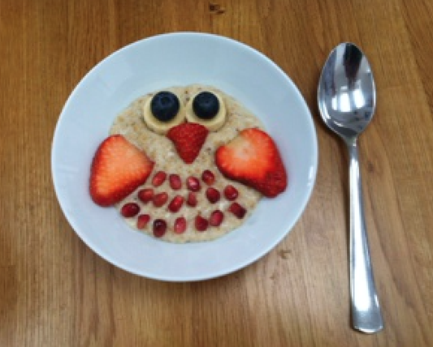
A Hooting Healthy Breakfast

Slide 24
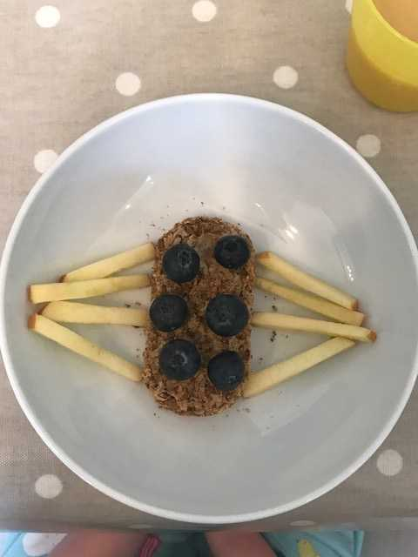
Spiderbix

Slide 25
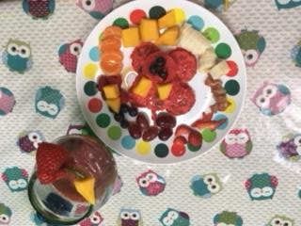
Wooftastic Breakfast

Slide 26
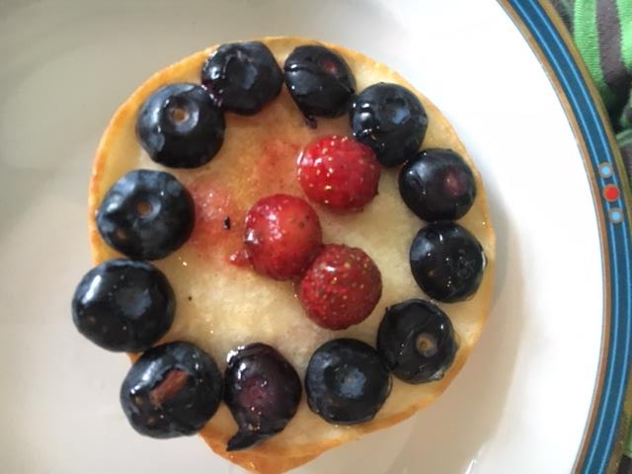
Berry Nice Buckwheat pancakes

Slide 27
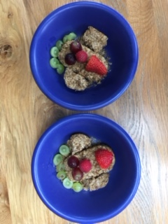
Bixie birds

Slide 28
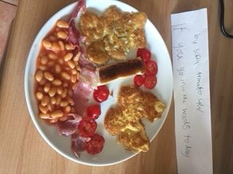

Slide 29
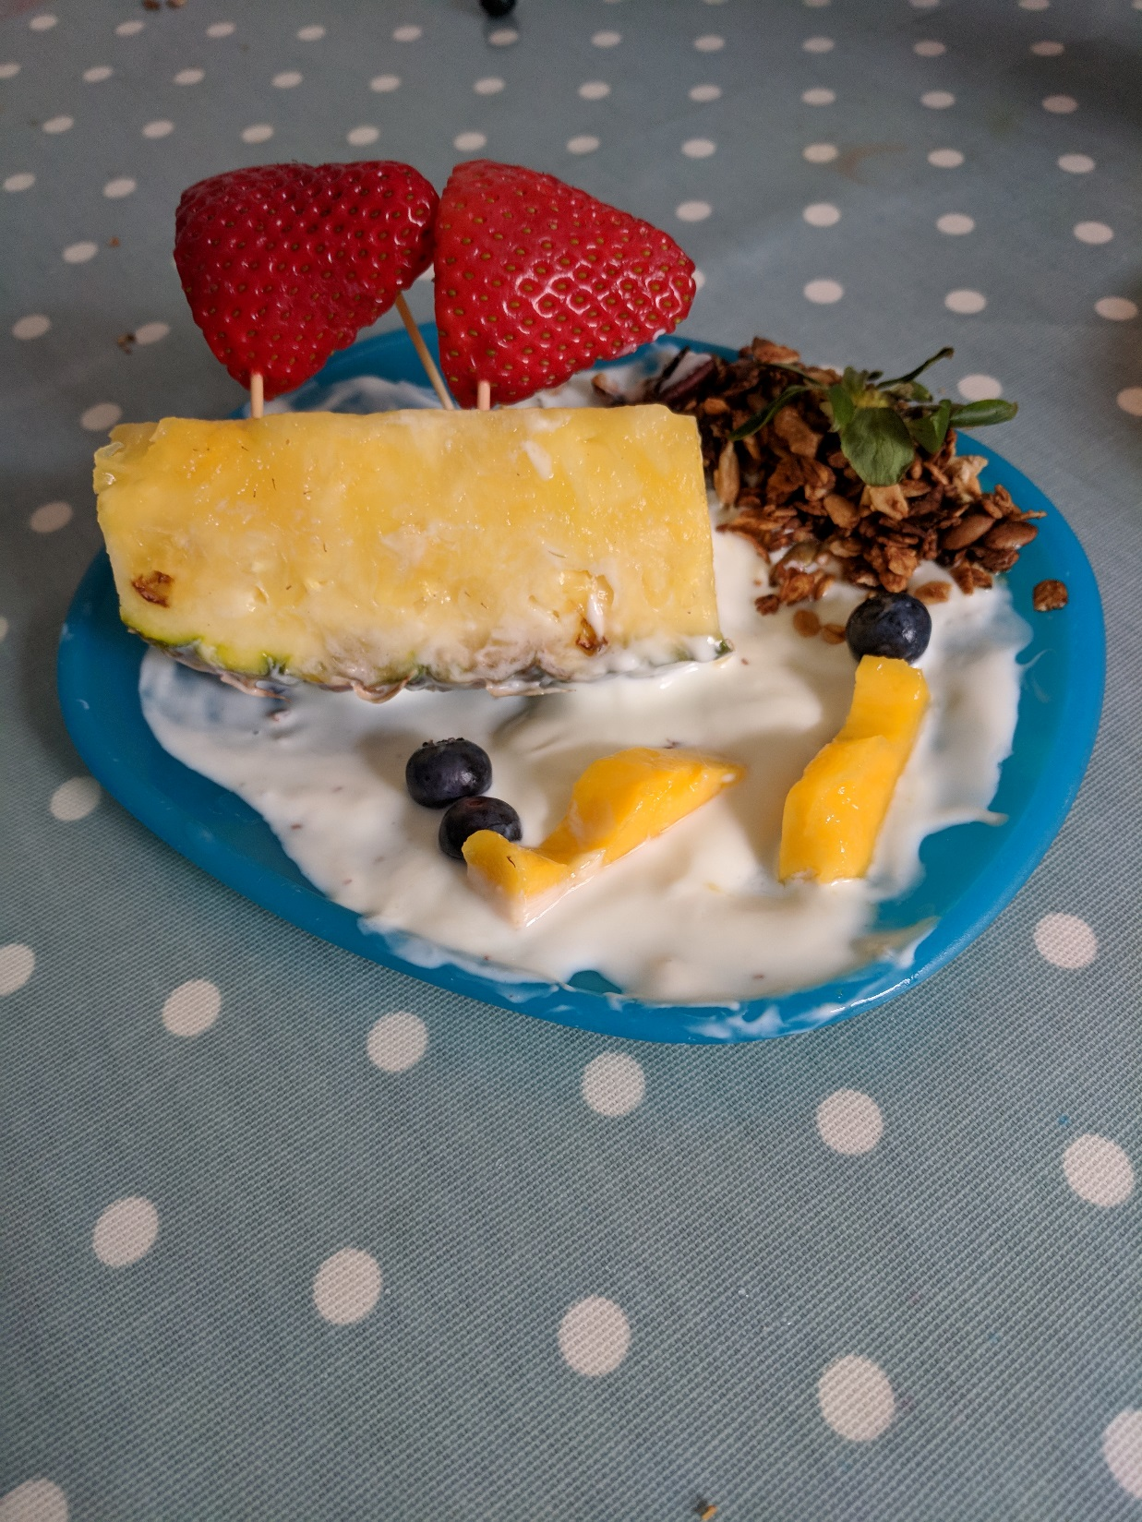
Topsy Turvy but no scurvy

Slide 30
And the winners are for their healthiness,
Creativity and
funny title…..

Slide 31
KS 1
KS2

